Slide 1
INTRO to DATA SCIENCE Lecture 1: What is data science?
Notes:
~15-20 min on initial stuff
Note: example DS problem…write down some features, how could you build a predictive model from these?

Slide 2
WELCOME!
INTRO TO DATA SCIENCE
Notes:
Introductions
discuss student backgrounds
discuss reasons for interest in data science

Slide 3
Instructor: Anthony Erlinger Teaching Assistants: Josh Schneier, Deepti Gottipati E-mail: aerlinger@gmail.com Course Times: 6:30pm-9:30pm, Tuesdays and Thursdays Location: 10 E. 21st Street, Room 4A (4th floor) Office Hours: TBD (Will send out survey with avail. times)
Logistics
Notes:
All of our classes will involve some hands-on work (in the exercises section)

Slide 4
Logistics
Syllabus posted on Github:
https://github.com/ga-students/DAT_20_NYC
Order of content presentation may change, but topics will remain the same
Make sure you:
Have access to the above repository
Access to Slack
Completed all of the pre-course material
Notes:
All of our classes will involve some hands-on work (in the exercises section)

Slide 5
I. What is data science? II. The Data mining workflow Lab: III. Basic git usage IV. Setting up your development environment
agenda
Notes:
All of our classes will involve some hands-on work (in the exercises section)

Slide 6
I. What is data science?
INTRO TO DATA SCIENCE
Notes:
~15-20 min for this section?

Slide 7
What is DATA SCIENCE?
A set of tools and techniques used to extract useful information from data.
Notes:
This is pretty high level
Q: what kinds of tools & techniques do you think this means? (subject of this course…”useful” depends on the particular problem)
in general, DS is used to make intelligent decisions (frequently to satisfy business requirements)
Q: does anyone know of any examples?

Slide 8
What is DATA SCIENCE?
A set of tools and techniques used to extract useful information from data.
An interdisciplinary, problem-oriented subject.
Notes:
Combines math, computing, problem solving skills, communication
Practical subject, not very formal/rigorous.
Problem solving skills are key!

Slide 9
What is DATA SCIENCE?
A set of tools and techniques used to extract useful information from data.
An interdisciplinary, problem-solving oriented subject.
The application of scientific techniques to practical problems.
Notes:
Scientific = math & computing as above…practical = important to biz (etc)
Not a rigid, axiomatic discipline…lots of stuff is new & still-evolving.

Slide 10
What is DATA SCIENCE?
A set of tools and techniques used to extract useful information from data.
An interdisciplinary, problem-solving oriented subject.
The application of scientific techniques to practical problems.
A rapidly growing field.
Notes:
You’re here because you’ve heard of it & you want to know more!

Slide 11
What is DATA SCIENCE?
A set of tools and techniques used to extract useful information from data.
An interdisciplinary, problem-solving oriented subject.
The application of scientific techniques to practical problems.
A rapidly growing field.
Notes:
You’re here because you’ve heard of it & you want to know more!

Slide 12
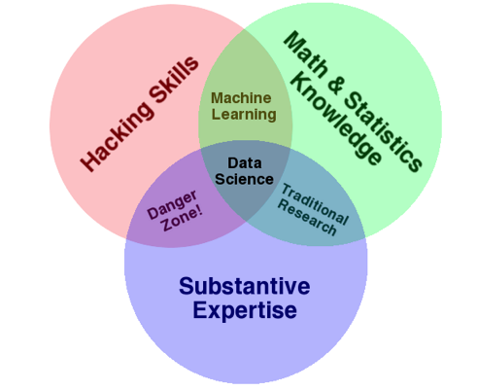
The qualities of a data scientist
source: http://www.dataists.com/2010/09/the-data-science-venn-diagram/
Notes:
Q: what could go wrong in the danger zone?

Slide 13

The qualities of a data scientist
ONE MORE THING!
Communication skills
source: http://www.dataists.com/2010/09/the-data-science-venn-diagram/
Notes:
without good communication skills, none of these will be much good to anyone
A data scientist’s most important responsibility (arguably) is explaining things clearly, often to non-technical people

Slide 14
What makes a good data scientist?
Notes:
Lots of names you’d expect (also obama, nyt → politics = growth area)
Q: can you think of any others? → show some example in the browser
Soon the question will be: who doesn’t use data science?

Slide 15
What makes a good data scientist?
Statistical and machine learning knowledge
Computer science and engineering experience
Academic curiosity
Product sense
Storytelling and communication skills
Ingenuity
Notes:
Lots of names you’d expect (also obama, nyt → politics = growth area)
Q: can you think of any others? → show some example in the browser
Soon the question will be: who doesn’t use data science?

Slide 16










who uses data science?
Notes:
Lots of names you’d expect (also obama, nyt → politics = growth area)
Q: can you think of any others? → show some example in the browser
Soon the question will be: who doesn’t use data science?

Slide 17
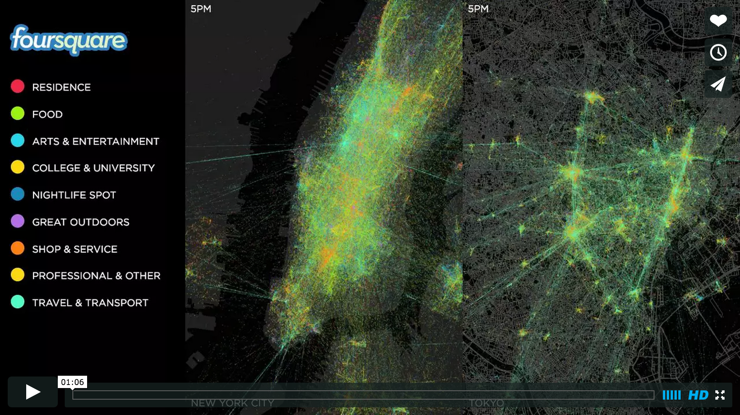
What is DATA SCIENCE?
Foursquare checkin data:
https://vimeo.com/62289901
Notes:
You’re here because you’ve heard of it & you want to know more!

Slide 18
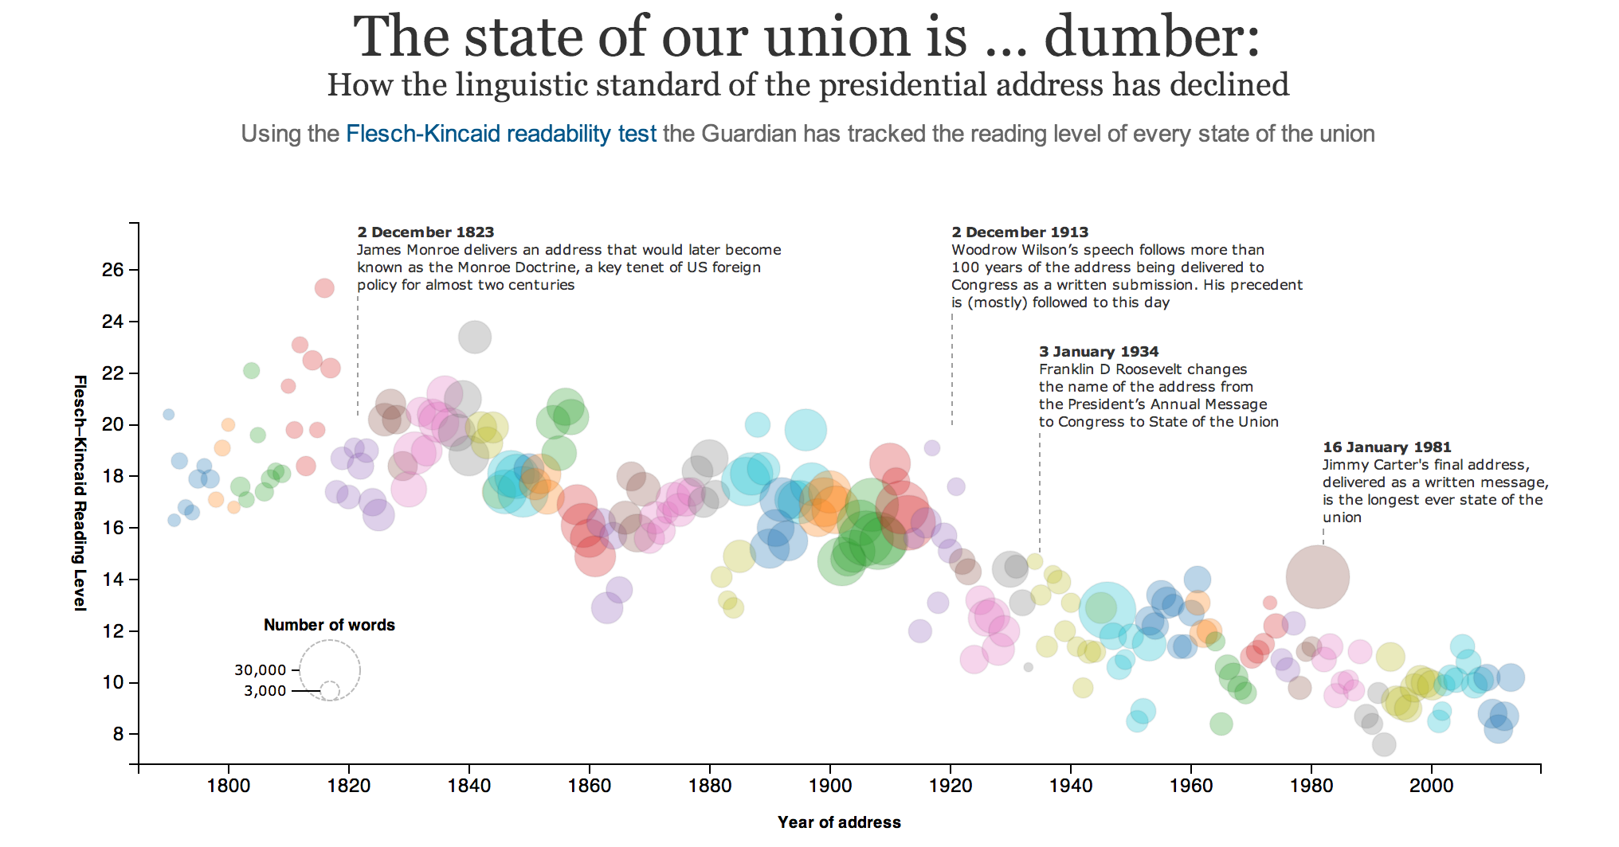
who uses data science?
Notes:
Lots of names you’d expect (also obama, nyt → politics = growth area)
Q: can you think of any others? → show some example in the browser
Soon the question will be: who doesn’t use data science?

Slide 19
who uses data science?
Stack Overﬂow tag recommendation and response time prediction
Locating ethnic food in ethnic neighborhoods
Building optimal NBA teams
Recommending new musical artists
Prioritize emergency calls in Seattle
Finding the right college for you
Notes:
Lots of names you’d expect (also obama, nyt → politics = growth area)
Q: can you think of any others? → show some example in the browser
Soon the question will be: who doesn’t use data science?

Slide 20
Ii. The data science workflow
INTRO TO DATA SCIENCE
Notes:
~15-20 min for this section?
So what does data science look like?

Slide 21
the data science workflow
Jeff Hammerbacher, Intro to Data Science Berkeley
1. Identify problem
2. Instrument data sources
3. Collect data
4. Prepare data (integrate, transform, clean, impute, filter, aggregate)
5. Build model
6. Evaluate model
7. Communicate results
source: http://berkeleydatascience.files.wordpress.com/2012/01/20120117berkeley1.pdf
Notes:
Fits into our earlier characterization pretty well (problem solving skills necessary throughout!)
New headers connected to visualization (part of communication)
Q: are these in order? (A: there really is no order)

Slide 22
the data science workflow
Ben Fry
1. Acquire
2. Parse
3. Filter
4. Mine
5. Represent
6. Refine
7. Interact
source: http://berkeleydatascience.files.wordpress.com/2012/01/20120117berkeley1.pdf
Notes:
Fits into our earlier characterization pretty well (problem solving skills necessary throughout!)
New headers connected to visualization (part of communication)
Q: are these in order? (A: there really is no order)

Slide 23
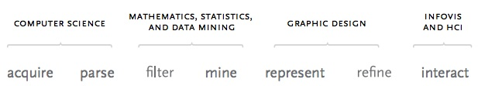
the data science workflow
Jeff Hammerbacher, Intro to Data Science Berkeley
1. Identify problem
2. Instrument data sources
3. Collect data
4. Prepare data (integrate, transform, clean, impute, filter, aggregate)
5. Build model
6. Evaluate model
7. Communicate results
source: http://berkeleydatascience.files.wordpress.com/2012/01/20120117berkeley1.pdf
Notes:
Fits into our earlier characterization pretty well (problem solving skills necessary throughout!)
New headers connected to visualization (part of communication)
Q: are these in order? (A: there really is no order)

Slide 24
the data science workflow
The “premodel workflow”
source: http://benfry.com/phd/dissertation-110323c.pdf
Notes:
Fits into our earlier characterization pretty well (problem solving skills necessary throughout!)
New headers connected to visualization (part of communication)
Q: are these in order? (A: there really is no order)

Slide 25
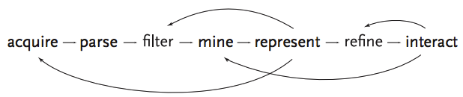
the data science workflow
NOTE
This diagram illustrates the iterative nature of problem solving
source: http://benfry.com/phd/dissertation-110323c.pdf
Notes:
Solving problems iteratively: not a straight line (eg, there’s really no correct order)
Start small & work your way out…Don’t try to do everything in a single step!
Q: why not?

Slide 26
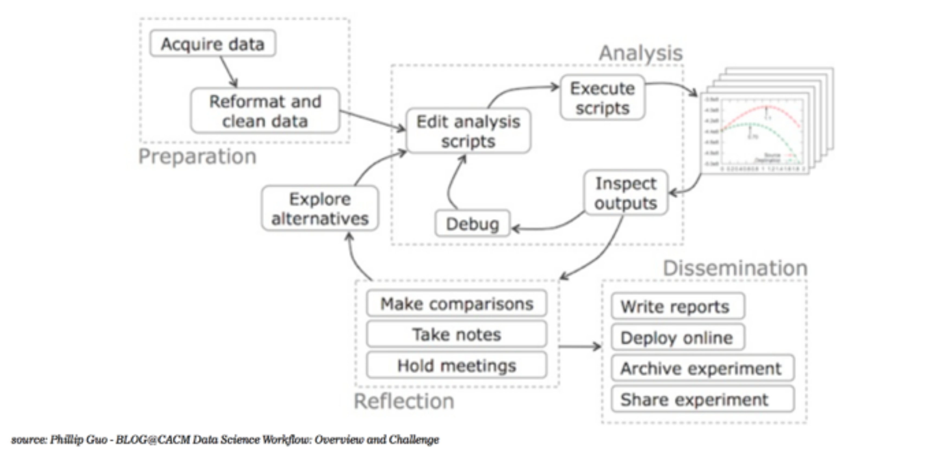
The workflow

Slide 27
What is DATA SCIENCE?
Revisiting the Foursquare data
https://vimeo.com/62289901
Notes:
You’re here because you’ve heard of it & you want to know more!

Slide 28
III. Using git
INTRO TO DATA SCIENCE
Notes:
~45 min?
Let’s do some warmups before we start hacking at our first dataset

Slide 29
The workflow
In your terminal/command line:
$ git clone
git@github.com:ga-students/DAT_20_NYC.git
$ cd DAT_20_NYC/Lesson01/exercises
$ python SimpleDemo.py

Slide 30
IiI. working at the unix command line
INTRO TO DATA SCIENCE
Notes:
~45 min?
Let’s do some warmups before we start hacking at our first dataset

Slide 31
Exercise – working at the unix command line
Key objectives
tools
- Navigate the filesystem
- Create, move, copy, and delete files & directories
- View & search files
- Edit & interact with files
- Combine steps
- Learn more
- ls, cd
- cat, touch, mv, cp, mkdir, rm, rmdir
- head, tail, less, cat, grep
- vim, tr, sort, uniq, wc
- pipe (|)
- man, apropos
NOTE
Being comfortable at the command line makes your life much easier!
Notes:
These are some initial very *practical* command line tools…we will be using these regularly & seeing many more as the course progresses (discuss why to do this before loading into R/Python)
Q: are any of these unfamiliar? Can you think of any other important basic tools?
Q: who has heard of/used vim, emacs, gnuplot, numpy/scipy/pandas, homebrew, tmux, julia? Just (to get an idea of the pace of the class)

Slide 32
Iv. Visualizations as a medium
INTRO TO DATA SCIENCE
Notes:
~45 min?

Slide 33
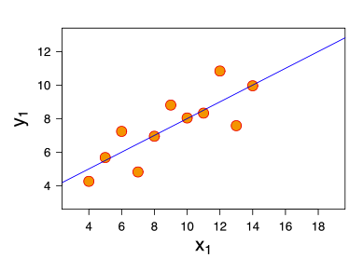
Exercise – why visualize data?
Consider the following dataset:
eleven (x, y) points
Notes:
So far so good

Slide 34
Exercise – why visualize data?
Consider the following dataset:
eleven (x, y) points
mean of x = 9, mean of y = 7.5
Notes:
Q: Does everyone know what the mean is?

Slide 35
Exercise – why visualize data?
Consider the following dataset:
eleven (x, y) points
mean of x = 9, mean of y = 7.5
variance of x = 11, variance of y = 4.1
Notes:
Q: Does anyone know what the variance is?
Q: More importantly, do you know what the variance tells you?

Slide 36
Exercise – why visualize data?
Consider the following dataset:
eleven (x, y) points
mean of x = 9, mean of y = 7.5
variance of x = 11, variance of y = 4.1
correlation of x and y = 0.8
Notes:
Q: Does everyone know what correl is?
Q: More importantly, do you know what correl tells you?

Slide 37
Exercise – why visualize data?
Consider the following dataset:
eleven (x, y) points
mean of x = 9, mean of y = 7.5
variance of x = 11, variance of y = 4.1
correlation of x, y = 0.8
line of best fit: y = 3.00 + 0.500x
Notes:
Q: Does everyone know what a line of best fit is?
Q: More importantly, do you know what the line of best fit tells you? (note: we will look at this next time)

Slide 38
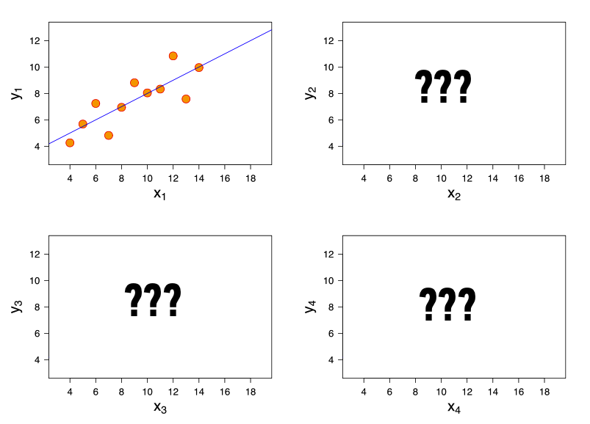
Exercise – why visualize data?
Now, suppose I give you
three more datasets
with exactly the same
characteristics…
Q: how similar are these datasets?

Slide 39
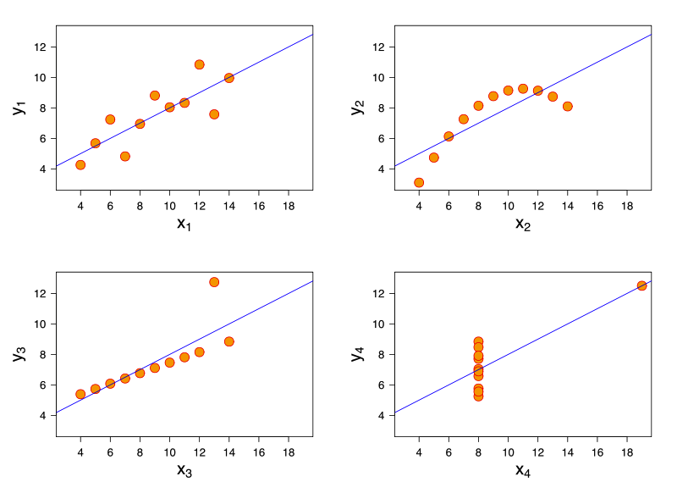
Exercise – why visualize data?
Now, suppose I give you
three more datasets
with exactly the same
characteristics.
Q: how similar are these datasets?
A: not very!
http://en.wikipedia.org/wiki/Anscombe's_quartet

Slide 40
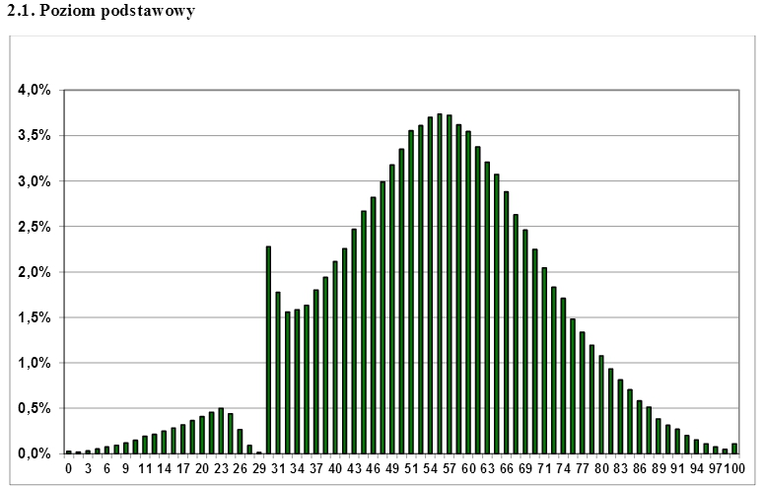
Exercise – why visualize data?
Distribution of results of the Matura (high school exit exam) in Poland

Slide 41
DISCUSSION
INTRO TO DATA SCIENCE
Notes:
~15 min
Q: What did you find difficult/confusing?
Q: What did you find interesting?

